Slide 2
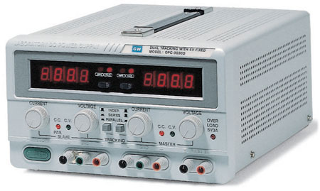
Switch for Voltage or Current
Voltage/Current Display
Adjust Current Limit
Adjust Voltage Limit
Power Button
CH. 1
CH. 2
V- (Black)
Fixed 5V Output
+V (Red)
Ground (Green)
Mode Indicator LEDs

Slide 3
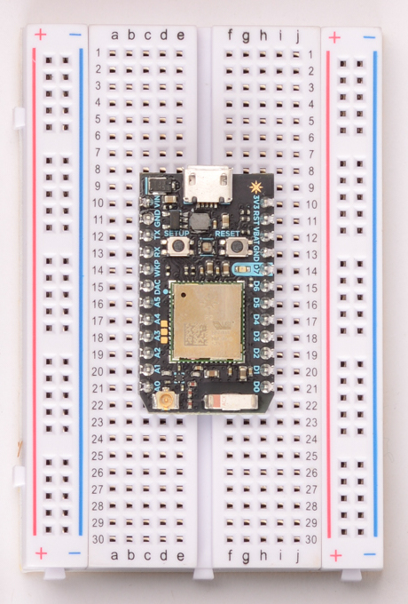
Jumpered horizontal pins
+V and –V supply rails (connected vertically)

Slide 4
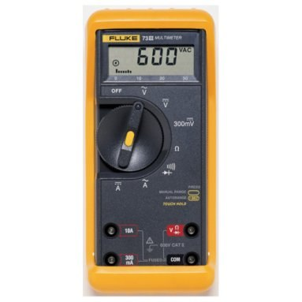
Fluke 73
AC Voltage
DC Voltage
Mode Selector
DC Voltage (mV)
Resistance
DC Current
Diode Test
Ac Current
Voltage, Resistance, Diode Test Terminal
Current Terminal (Amps)
Current Terminal (mA)
Common Terminal (Always Used)

Slide 5
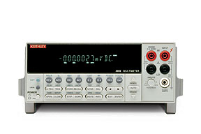
Keithley Digital Multimeter
Voltage and Resistance Test Terminal
Common Terminal (Always Used)
Power Switch
Current Terminal (Amps)
Mode/Option Selection Keys

Slide 6
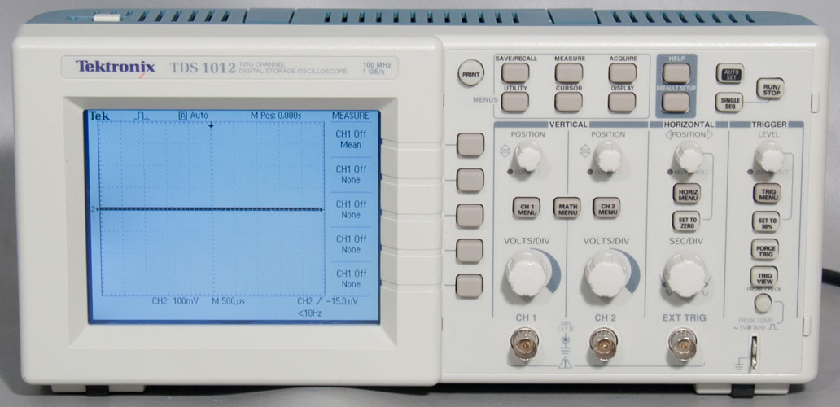
Power Switch
Shift Signal Position Up/Down
Menu Key for Measuring Signals
Auto-Scale X and Y
Change triggering level
X-Axis Scale (Time) Adjustment
CH. 2 Input
Menu Keys for Displayed Options
Y-Axis Scale Adjustment
CH. 1 Input

Slide 7
Tek
T Trig’d
Measure
Source Type
CH 1 PK-PK 10V
Measurement 1
1
2
Channel Indicator
CH 1 Freq. 10Hz
CH 2 PK-PK 200mV
3
2
CH 2 Freq. ?
4
CH 1 5.00V
CH 2 5.00V
M 25.0ms
CH 1 2.50V
CH 2 Y Axis Divisions
CH 1 Y Axis Divisions
Time (X Axis) Divisions

